Slide 2
Digital Forensics Lecture-20
By- Dr.subhranil Das
Assistant Professor
School of computer Science

Slide 3

File System Traces
An individual actions on a computer leave many traces that digital investigators.
For instance, when a file is downloaded from the Internet, the date-time stamps of this file represent when the file was placed on the computer.
If this file is subsequently accessed, moved, or modified, the date-time stamps may be altered to reflect these actions. Understanding how date-time stamps of files are updated under different circumstances can enable digital investigators to infer the associated actions.

Slide 4
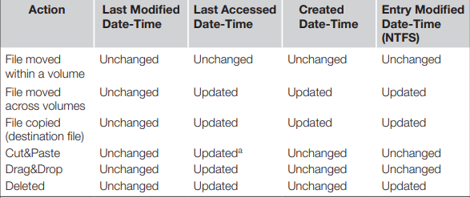
Date-Time Stamp Behavior on FAT and NTFS File Systems

Slide 5
Cut & Paste method
The Cut&Paste method does not alter the creation and entry modified date-time stamps of the destination file, whereas using the command line to copy a file updates the creation and entry modified date-time stamps.
Because moving a file within a volume does not change file times, the original (deleted) folder entry for the file is identical to the new folder entry, enabling forensic examiners to determine where files were moved from as long as the original folder entry exists.
When a file with these counterintuitive date-time stamps is found indicates that it was copied from somewhere else, it may be possible to locate the original file by searching all available storage media for files with the same MD5 hash value, the same creation time, and/or the same name.

Slide 6
Operation on Windows
Windows 95/98 stores information relating to printed files in C:\ Windows\Spool\Printers and Windows NT/2000 stores them in C:\WinNT\ System32\Spool\Printers.
These files can contain the name (or URL) of the printed file, application used to print, printer name, file owner, and even the raw data of the print job in.
Also, as these files are created when the associated item is printed, the date-time stamps on these files indicate when it was printed.
When printing in EMF mode, the associated spool file (0020.SPL) contains names of temporary files that were created during the printing process as shown her

Slide 7
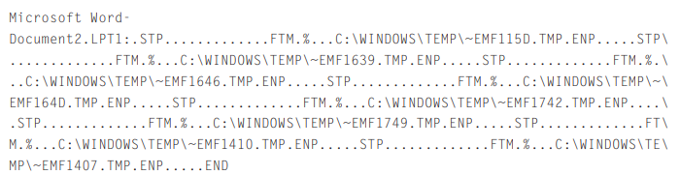
Metafiles
These temporary enhanced metafiles essentially contain an image of segments of the printed document. Some of these EMF files may have been overwritten but those that still exist on disk can be opened with a suitable viewer to see what was printed. These copies can be useful if the original file is modified, encrypted, or non-existent, as in the above example, “Document2” was never saved

Slide 8
Data Recovery
Although automated tools are necessary to perform routine forensic examination tasks.
There are two main forms of data recovery in FAT and NTFS file systems, recovers the deleted data from unallocated space and recovering data from slack space.
Recently deleted files can sometimes be recovered from unallocated space by reconnecting links in the chain .
For instance, to recover the deleted file named “greenfield.doc” on the aforementioned floppy diskette it is necessary to modify its entry in the root folder, replacing the sigma (“σ”) with an underscore (“_”) as shown here.
The sigma is used on FAT file systems to indicate that a file is deleted.

Slide 9
Data Recovery
The file begins at cluster 275 and its size is the equivalent of 39 clusters (19,968 bytes ÷ 512 bytes/cluster = 39 clusters).
Assuming that all of these clusters are contiguous, the FAT can be modified to reconstruct the chain as shown here in bold.

Slide 10
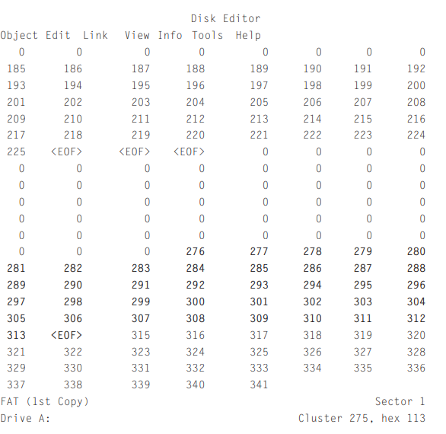
Output from Disk Editor

Slide 11
Windows based recovery tools
The recovery process described above is time consuming and must be performed on a working copy of the original disk.
More sophisticated analysis tools like EnCase, FTK, and X-Ways can use a bitstream copy of a disk to display a virtual reconstruction of the file system, including deleted files, without actually modifying the FAT.
All of these tools recover files on FAT systems in the most rudimentary way, assuming that all clusters in a file are sequential.
Therefore, in more complex situations, when files are fragmented, it is necessary to recover files manually.
Most Windows-based forensic tools can also be used to recover deleted files on NTFS volumes.

Slide 12
Unix based recovery tools
Linux can be used to perform basic examinations of FAT and NTFS file systems.
Tools such as the Sleuth Kit and SMART6 can be used to recover deleted files from FAT and NTFS file systems.
For instance, the Sleuth Kit, combined with the Autopsy Forensic Browser, can be used to examine FAT file systems through a Web browser interface and recover deleted files.
The Sleuth Kit and Autopsy Forensic Browser enable digital investigators to examine data at the logical and physical level.
The Sleuth Kit can also be used to recover slack space from FAT and NTFS systems using “dls -s.”

Slide 13
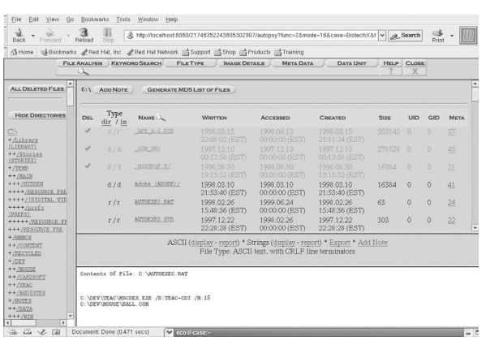
The Sleuth Kit and Autopsy Forensic Browser being used to examine a FAT file system

Slide 14
Next Lecture
Digital Evidences in Windows System
.

